Slide 1
Climate Data Analysis-as-a-Service (Aaas)
Serving ESGF CWT and NASA CDS
Thomas Maxwell, Charles Doutriaux, Dan Duffy, Mark McInerney

Slide 2
Climate Data Analytic Services (CDAS) Goals
Develop Climate Data Analytic Services
Collaborate with the ESGF CWT.
Serve analysis products to NASA projects.
CREATE-IP
Support interactive analytics.
Serve as testbed for climate AaaS development.
Uncover key challenges
Explore and compare existing capabilities
Develop missing capabilities

Slide 3
AaaS Performance Bottleneck: IO
Climate data analysis is heavily IO bound.
IO time typically 1-3 orders of magnitude > compute time.
Centralized disk/file systems are a bottleneck for (parallel) IO.
Trend toward distributed share-nothing architectures.
Many parallel independent node-local IO streams
Move computation to the data.
Alternate Approaches:
Existing: HDFS, Hadoop, MapReduce, etc.
Custom: Distributed IO/cache system for climate data.
Python/numpy.
NetCDF/ESGF data archives.

Slide 4
CDAS Requirements
Access data in raw (NetCDF, HDF) format.
Avoid supporting additional data copies for array databases, etc.
Cache variables of interest in domain (xyzt) of interest.
Support existing (python) climate data analysis operators.
All analysis operations developed in 100% python.
Parallelize data, not analysis packages.
Support ESGF Compute Working Team API.
Utilize the OpenGIS Web Processing Service (WPS) Interface Standard.
Modular design.
Easily integrate emerging technologies and support multiple approaches.
Impose negligible overhead on interactive operations.
Light weight implementation using Flask.

Slide 5
CDAS: Analysis as a Service Infrastructure
CDS AaaS Service
ToolBase
Kernel Manager
Compute Engine Manager
Staging Manager
ESMF
NCL
Client
timeseries
local
NCO
CDO
MPI
Web
averages
celery
celery
UVCDAT
Javascript API
spark
WPS
EOFS
R
Domain Manager
ESGF-CWT API
Application
SciPy
…
Python API
Data Manager
Long Term Data Store
Decomposition
Manager
ESGF
Memory cache
ESGF API
Time strategy
HDF
Disk cache
Space strategy
NetCDF

Slide 6
Dynamic Distributed Cache
Cache-0
Cache-1
Cache-2
Cache-3
Master Node
Worker-0
Worker-2
Worker-3
Worker-1
WPS Server

Slide 7
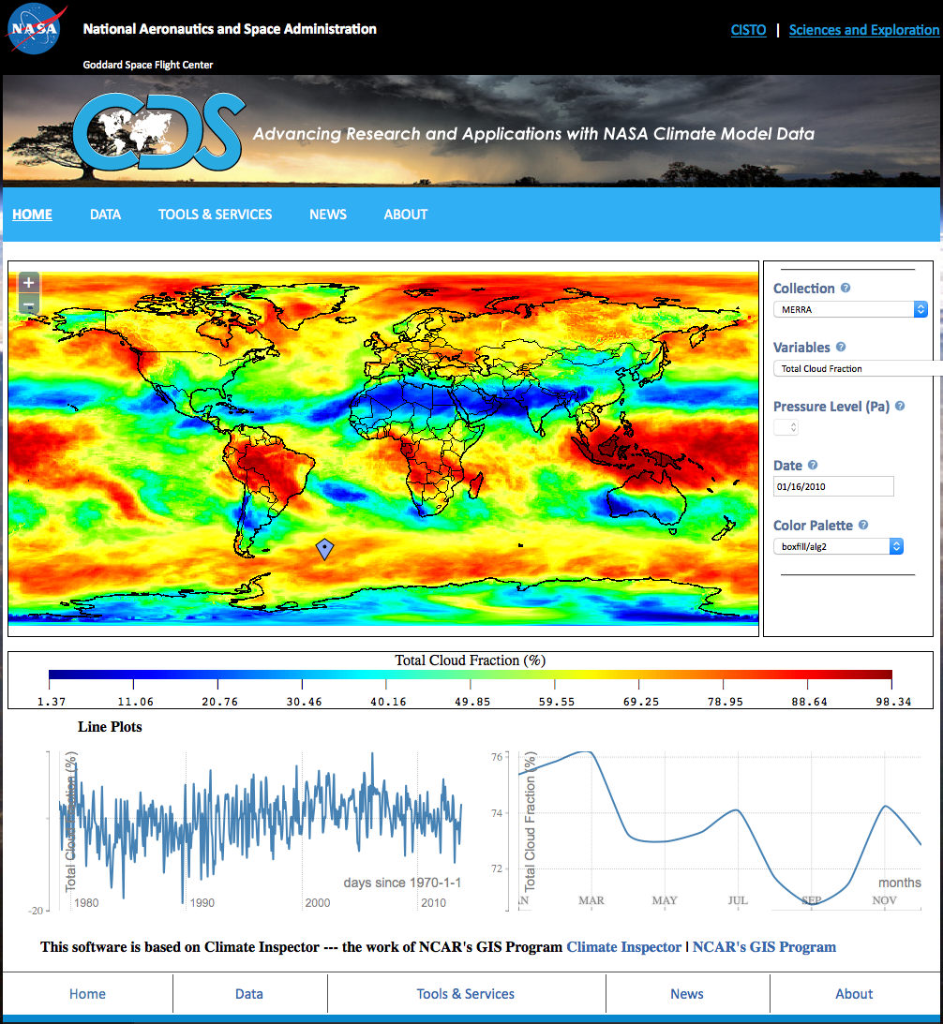
CREATE-V CDAS Client
An interactive web application that expands GIS mapping capabilities for manual analysis of reanalysis data
Provides climate and non-climate scientists with ability to visualize reanalysis data, select variables, parameters and color maps
Permits decision makers to investigate climate changes around the globe, through time, inspect model trends, compare multiple reanalysis datasets, and variability

Slide 8
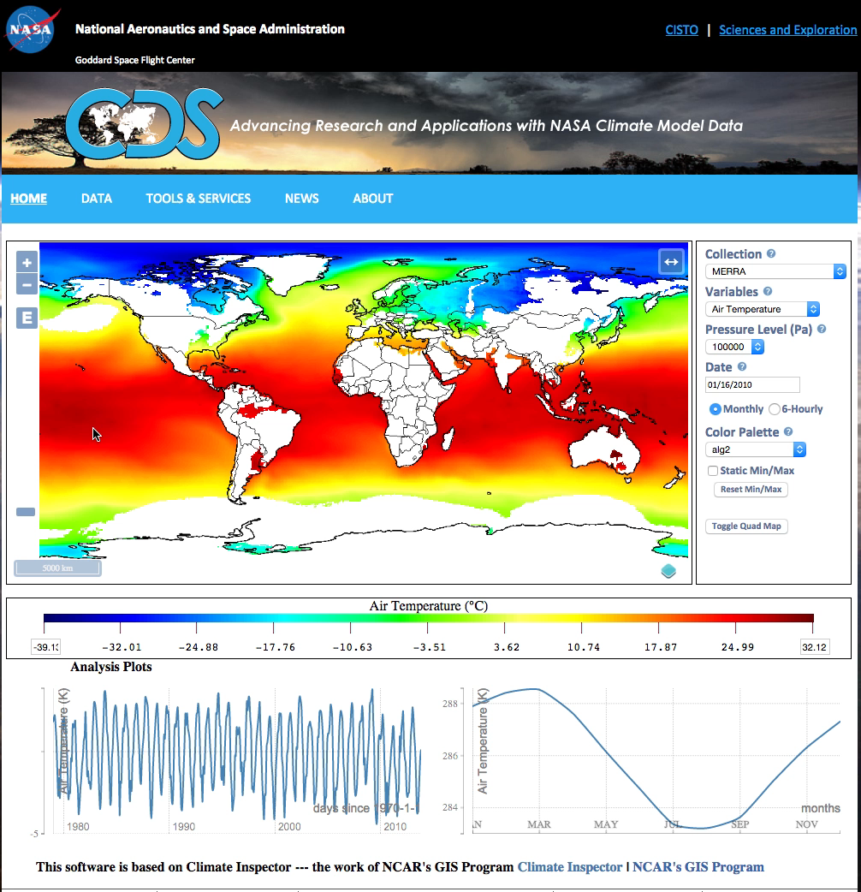
CDAS Analytic Services for Create-V

Slide 9
WPS API Structure
http://cda.nccs.nasa.gov/wps ?
service = WPS &
version = 1.0.0 &
request = Execute &
identifier = cdas &
async = false &
embedded = true &
datainputs = [
domain = {…};
variable = {...};
operation = […];
]

Slide 10
WPS Variable Specification
variable = [
{
"dset": "MERRA/mon/atmos",
"id": "v0:hur",
"domain": "d0”
},
{
"url": "http://ds.nccs.nasa.gov…/MERRA/mon/atmos",
"id": "v1:clt",
"domain": "d1”
}
]

Slide 11
WPS Domain Specification
domain = [
{ "id": "d0",
"longitude": [ ‐104.7,‐50.6 ],
"latitude": { "start": 0.0, "end":45.0, "system": ”values” },
},
{ "id": "d1",
"lon": 50.2,
"level": { "start":0, "end":1, "system": "indices” }
"time": "2010‐01‐16T12:00:00”
}
]

Slide 12
WPS Operation Specification
Operation = [
"CDAT.departures( v0, slice:t, domain:d2 )",
“CDAT.climatology($1, slice:t, bounds: annualcycle)",
“CDAS.value( v0, dom:d3 )",
“CDAT.average( *, slice:exy )”
“CDAS.cache( v1, dom:d1 )”
“va:CDAT.average( v0, slice:t )",
“CDAT.difference( v0, va, slice:t )”
]

Slide 13
What’s Next?
Collaborate with CWT on API and framework development.
Add new kernel operations.
Continue development of Domain Manger.
Distributed processing.
Continue development of Cache Manger.
Shared disk vs. shared nothing.
Server side plotting and visualization.

